Slide 1
Anonymity in Cryptocurrencies Through Mixing Services
Summer School, Croatia
June 2018
Foteini Baldimtsi
foteini@gmu.edu
Notes:
<number>

Slide 2
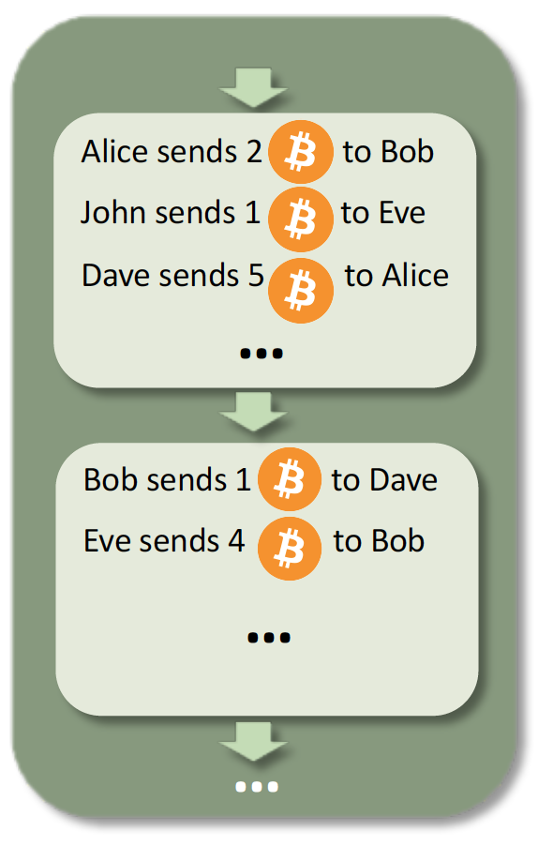
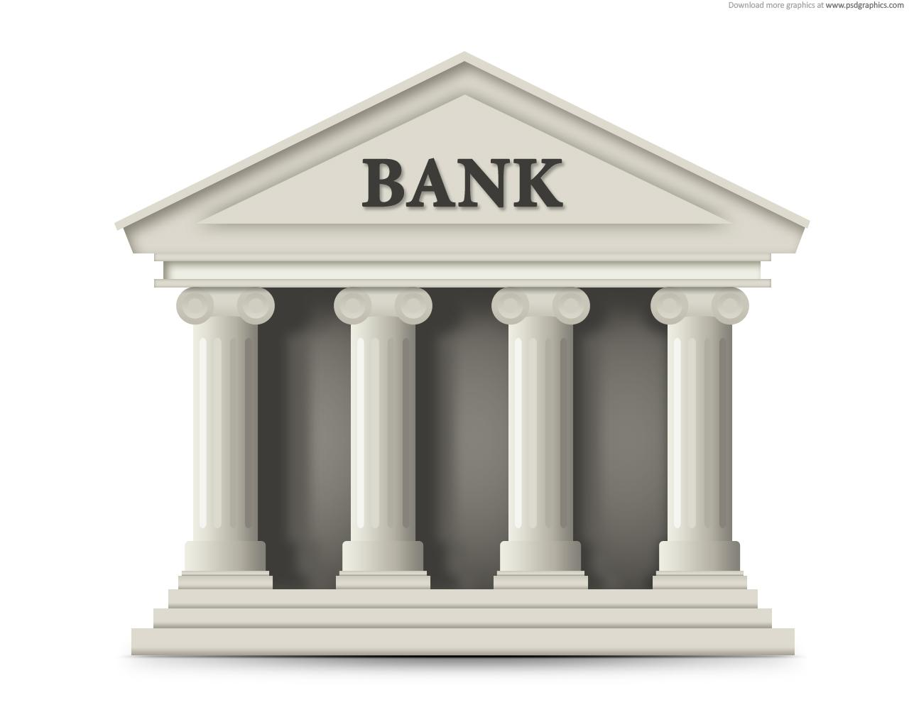
The Blockchain at the heart of a cryptocurrency

Slide 3
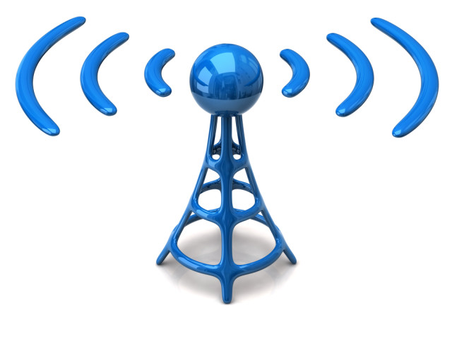
Who maintains the Bitcoin Blockchain?
Every transaction is broadcasted to all users

Slide 4
Who maintains the Bitcoin Blockchain?
Every transaction is broadcasted to all users
Is this the right view of the blockchain?
Voting -> majority wins
Yes
No
Yes
Yes
Yes
Works well if users are all honest but this is not the case in practice!

Slide 5
We have a problem!
What does majority mean in a system that everyone is free to participate?
Sybils: Multiple identities belonging to the same (malicious) user

Slide 6
Bitcoin solution
Majority is defined as the majority of computational power!
Sybil creation doesn’t increase attackers computational power ;)

Slide 7
How to check majority of computational power?
Proof of work
In order to ``measure’’ a user’s computational power I ask him to solve a puzzle:
puzzle should be difficult to solve
but, a solution should be easily verifiable

Slide 8
How to check majority of computational power?
Proof of work
In order to ``measure’’ a user’s computational power I ask him to solve a puzzle:
puzzle should be difficult to solve
but, a solution should be easily verifiable
The puzzle used in Bitcoin is based in cryptographic hash functions (SHA-256)
f(x) = y
Puzzle: Given y find x!

Slide 9
Bitcoin Blockchain Format
A block is added every 10 minutes and has size <1MB
1 block
How many transactions per second are supported by Bitcoin?
4 - 6

Slide 10
Format of a Bitcoin Transaction
Alice
Bob
Alice sends 1 to Bob

Slide 11
Format of a Bitcoin Transaction
Alice
Bob
PK: hUK67H9fyg
PK: p2Pknb7frT
hUK67H9fyg sends 1 to p2Pknb7frT
SK: z4Pxc2kKn3
SK: n52Hb9Klp
Signed under Alice’s SK!
A transaction is valid only if the signature verifies
Technically, monetary values are assigned to transactions and not Public-Keys
Bitcoin transactions can have multiple inputs and multiple outputs

Slide 12
Is Bitcoin Anonymous?
r4GtfDsxc sends 1 to lk9Ikg5Fv9
hUK67H9fyg sends 1 to p2Pknb7frT
aLPknl5frA sends 1 to kc6fR4d2s
n4ft5ThK sends 1 to aLPknl5frA
kldks7Gt55 sends 1 to kL9p1aSdR
k96tDgt sends 1 to aLPknl5frA
p2Pknb7frT sends 1 to m6F9o8asZx
jfT76gv3sa sends 1 to kJh87Dts9d
Bitcoin only offers pseudo-anonymity. Transactions are linkable and can be potentially de-anonymized
What if I create fresh/ephemeral addresses for each transfer?
shared spending implies joint control
taint analysis
side channel attacks (i.e. network timing etc)
auxiliary information (i.e. a PK in my website etc)
Notes:
<number>

Slide 13
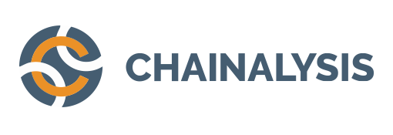
Is Bitcoin Anonymous?
r4GtfDsxc sends 1 to lk9Ikg5Fv9
hUK67H9fyg sends 1 to p2Pknb7frT
aLPknl5frA sends 1 to kc6fR4d2s
n4ft5ThK sends 1 to aLPknl5frA
kldks7Gt55 sends 1 to kL9p1aSdR
k96tDgt sends 1 to aLPknl5frA
p2Pknb7frT sends 1 to m6F9o8asZx
jfT76gv3sa sends 1 to kJh87Dts9d
Bitcoin only offers pseudo-anonymity. Transactions are linkable and can be potentially de-anonymized
Notes:
<number>

Slide 14
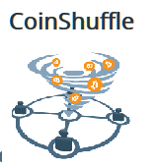
Bitcoin is not anonymous....what do we do?
Option 1: forget about it! Let’s build new systems
Option 2: build mixers/tumblers compatible with Bitcoin
Blindcoin
TumbleBit
XIM
Notes:
<number>

Slide 15
Mixing Services (1st generation)
Payers
Payees
Break the link between payer and payee
Notes:
<number>

Slide 16
Mixing Services (1st generation)
Payers
Payees
MIX
?
Every payer sends coins from their address A_{i} to a mixing service to be later received in address B_{i}
The mixer will hold the coins for some escrow period and then randomly assign received coins to B_{i} addresses (for a fee)
Users (hopefully!) pick up their coins
Notes:
<number>

Slide 17
Mixing Services (1st generation)
Payers
Payees
MIX
?
Set Anonymity: the set of transactions which the adversary cannot distinguish from your transaction (depends on anonymity model)
Notes:
<number>

Slide 18
Mixing Services (1st generation)
Payers
Payees
MIX
?
From Bitcoin Wiki:
Notes:
<number>

Slide 19
Mixing Services
Payers
Payees
MIX
?
2 main challenges
security against intermediary (theft protection)
privacy against intermediary
Notes:
<number>

Slide 20
Mixing Services
Payers
Payees
MIX
?
2 directions
centralized (using an intermediary)
decentralized (direct communication of participants)
Notes:
<number>

Slide 21
Overview of Mixing Services
Decentralized Solutions
Centralized Solutions
Require coordination
Tumbler Availability
Vulnerable to DoS & Sybil Attacks
+
Small Anonymity Set
Vulnerable to Bitcoin Theft
Tumbler breaks anonymity
TumbleBit
Mixing takes hours
Xim
**Mobius
Notes:
Decentralized solutions: anonymity set of maximum ~540 transactions (because of size of Bitcoin transaction). DoS: a user joins the mix and then aborts, disrupting the protocol for all other users. Sybils: trick Alice A into mixing with them in order to deanonymize her payments

Slide 22
Tumblebit:
An Untrusted Bitcoin-Compatible Anonymous Payment Hub
Joint work: Ethan Heilman, Leen Al Shenibr, Alessandra Scafuro, Sharon Goldberg
Thanks to Ethan for some of the slides!
Notes:
<number>

Slide 23
TumbleBit is:
Private: Unlinkable Bitcoin payments and k-anonymous mixing,
Untrusted: No one including Tumbler can steal or link payments.
Scalable (many payments): scales transaction velocity and volume.
Compatible: Works with today's Bitcoin protocol.
Why is compatibility hard?
Our protocol must work with highly constrained Bitcoin scripts which provide two very limited cryptographic operations. Transactions can check ECDSA sigs and hash preimages.
Two ways to use TumbleBit:
When used to make many payments, TumbleBit helps scale Bitcoin’s transaction velocity (faster payments), and transaction volume (more payments).
TumbleBit can be used as a classic Bitcoin tumbler:
k-anonymity within a mix,
4 transactions confirmed in 2 blocks (~20mins)
When TumbleBit is used to make many payments:
Unlinkability within the payment phase,
Payments confirmed in seconds,
Payments are off-blockchain, ... don’t take up space on the blockchain.
Notes:
TumbleBit provides private, untrusted, payments. When used as a payment hub it can leverage the scalability of payment channels.
It provides privacy even if the tumbler is malicious, due to its architecture TumbleBit can scalable to very large sets of payments.

Slide 24
Towards Building Tumblebit Payment channels
Goal: make multiple Bitcoin transactions without commiting all of the transactions to the Bitcoin blockchain
One candidate implementation is by Hashed Timelock Contracts (HTLCs)
Notes:
<number>

Slide 25
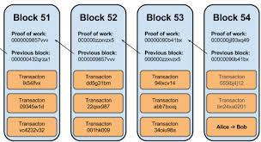
Towards Building Tumblebit Payment channels
Hub
Setup a payment channel
(on Blockchain transaction)
Alice
10
Notes:
Alice and Bob know that they will be often paying each other so they want to avoid using the Bitcoin blockchain all the time.
Payment channel = local two party consensus Create a multisignature transaction which is something like a balance sheet

Slide 26
Towards Building Tumblebit Payment channels
Hub
Setup a payment channel
(on Blockchain transaction)
Alice
Transaction: Escrow
Output Script: 2-of-2 multisig Must be signed by Alice and Hub
10
Create a multisig address/ public-key for Alice and Hub
Send the funds to this address
The funds are spendable if both Alice and the Hub sign
Notes:
Create a multisignature transaction - only valid (spentable) if both sign.
Alice starts and puts in 10 BTC, and waits for Bob to also put his money and sign.
If Bob doesn’t then the transaction has a time-out time, expiration and after this Alice gets her money back.

Slide 27
Towards Building Tumblebit Payment channels
Hub
Setup a payment channel
(on Blockchain transaction)
Alice
Transaction: Escrow
Output Script: 2-of-2 multisig Must be signed by Alice and Hub
10
Post on Blockchain

Slide 28
Towards Building Tumblebit Payment channels
Hub
Setup a payment channel
(on Blockchain transaction)
Alice
Transaction: Escrow
Output Script: 2-of-2 multisig Must be signed by Alice and Hub
10
Post on Blockchain
Alice wants to transfer 2 to Hub
Notes:
Now that they have set up the channel they can start doing off-blockchain transactions, just between them. No need for blockchain thus scalability problems are not of concern here - no need to overload the blockchain.

Slide 29
Towards Building Tumblebit Payment channels
Hub
Setup a payment channel
(on Blockchain transaction)
Alice
Transaction: Escrow
Output Script: 2-of-2 multisig Must be signed by Alice and Hub
10
Post on Blockchain
Direct payments between them
(off Blockchain transaction)
Alice wants to transfer 2 to Hub
Notes:
Here Alice only signs and gives it to Bob

Slide 30
Towards Building Tumblebit Payment channels
Hub
Setup a payment channel
(on Blockchain transaction)
Alice
Transaction: Escrow
Output Script: 2-of-2 multisig Must be signed by Alice and Hub
10
Post on Blockchain
Transaction: Claim
Alice 8 Hub 2
σ₁
Direct payments between them
(off Blockchain transaction)
Alice wants to transfer 2 to Hub
Notes:
Here Alice only signs and gives it to Bob

Slide 31
Towards Building Tumblebit Payment channels
Hub
Setup a payment channel
(on Blockchain transaction)
Alice
Transaction: Escrow
Output Script: 2-of-2 multisig Must be signed by Alice and Hub
10
Post on Blockchain
Transaction: Claim
Alice 8 Hub 2
σ₁
Direct payments between them
(off Blockchain transaction)
…
Transaction: Claim
Alice 3 Hub 7
σ₁
σ₁
Notes:
Here Alice only signs and gives it to Bob

Slide 32
Towards Building Tumblebit Payment channels
Hub
Setup a payment channel
(on Blockchain transaction)
Alice
Transaction: Escrow
Output Script: 2-of-2 multisig Must be signed by Alice and Hub
10
Post on Blockchain
Transaction: Claim
Alice 8 Hub 2
σ₁
Direct payments between them
(off Blockchain transaction)
…
Transaction: Claim
Alice 3 Hub 7
σ₁
σ₁
Notes:
Here Alice only signs and gives it to Bob

Slide 33
Towards Building Tumblebit Payment channels
Hub
Setup a payment channel
(on Blockchain transaction)
Alice
Transaction: Escrow
Output Script: 2-of-2 multisig Must be signed by Alice and Hub
10
Post on Blockchain
Transaction: Claim
Alice 8 Hub 2
σ₁
Direct payments between them
(off Blockchain transaction)
…
Transaction: Claim
Alice 3 Hub 7
σ₁
σ₁
σ₂
Post on Blockchain
Notes:
Here Alice only signs and gives it to Bob

Slide 34
Towards Building Tumblebit Payment channels
Hub
Setup a payment channel
(on Blockchain transaction)
Alice
Transaction: Escrow
Output Script: 2-of-2 multisig Must be signed by Alice and Hub
10
Post on Blockchain
Transaction: Claim
Alice 8 Hub 2
σ₁
Direct payments between them
(off Blockchain transaction)
…
Transaction: Claim
Alice 3 Hub 7
What if the Hub never added a signature?
σ₁
σ₁
σ₂
Post on Blockchain
Notes:
Here Alice only signs and gives it to Bob

Slide 35
Towards Building Tumblebit Payment channels
Hub
Setup a payment channel
(on Blockchain transaction)
Alice
Transaction: Escrow
Output Script: 2-of-2 multisig Must be signed by Alice and Hub
Refunded to Alice: after 1 month
10
Post on Blockchain
Transaction: Claim
Alice 8 Hub 2
σ₁
Direct payments between them
(off Blockchain transaction)
…
Transaction: Claim
Alice 3 Hub 7
What if the Hub never added a signature?
σ₁
σ₁
σ₂
Post on Blockchain
Notes:
Here Alice only signs and gives it to Bob

Slide 36
TumbleBit: Phases
1. Escrow Phase: All payment channels setup.
Escrow Phase: All payment channels setup.
Payments Phase (~1 month): Payers make payments.
Cashout Phase: Payers and payees close their payment channels.
2. Payments Phase (~1 month): Payers make payments.
Payers
Payees
σ
Payment Channel A₁:10, T:0
Payment Channel T:10, B₁:0
3. Cashout Phase: payers and payees close their payment channels.
Alice₁
Bob₁
Close channel T:5, B₁:5
Close channel T:8, B₁:2
Pay 1 BTC
Receive 1 BTC
Pay 2 BTC
Pay 3 BTC
Receive 2 BTC
Pay 4 BTC
Pay 5 BTC
Payment Channel A₂:10, T:0
Hub
Payment Channel T:10, B₂:0
Alice₂
Bob₂
Pay 1 BTC
Pay 2 BTC
Close channel T:3, B₂:7
Close channel T:0, B₂:10
(c,z),(c,z),(c,z),...
Pay 3 BTC
Receive 1 BTC
Receive 2 BTC
+1 BTC to Tumbler
Receive 10 BTC
Alice₃
Payment Channel A₃:10, T:0
Payment Channel T:10, B₃:0
Bob₃
Pay 1 BTC
Close channel T:7, B₃:3
Close channel T:7, B₃:3
(c,z),(c,z),(c,z),...
Pay 2 BTC
Pay 3 BTC
Pay 4 BTC
Receive 1 BTC
Pay 5 BTC
Pay 6 BTC
Receive 2 BTC
Pay 7 BTC
Receive 3 BTC
(c,z),(c,z),(c,z),...(c,z) σ σ σ ... σ
Notes:
<number>

Slide 37
Background: Payment Hub
A payment hub: routes payment channels.
Bob₁
Alice₁
But what if the hub is malicious and takes Alice2’s bitcoin and gives Bob3 nothing?
Sign(Alice-SK, Claim1)
Unidirectional Payment Channel Alice → Payment Hub
Unidirectional Payment Channel Payment Hub → Bob
Transaction: Escrow1
Output Script: 2-of-2 multisig Must be signed by Alice and Payment Hub Refunded to Alice: after 1 month
Transaction: Escrow2
Output Script: 2-of-2 multisig Must be signed by Payment Hub and Bob Refunded to Payment Hub: after 1 month
Sign(Alice-SK, Claim2)
X
Payment Hub
Alice
Transaction
Escrow1
Transaction
Escrow2
Bob
σ₁
Transaction
Claim1
σ₁
X
Transaction
Claim2
σ₂
σ₂
X
Tumbler
Alice₃
...But what if the hub is malicious, and takes Alice’s bitcoin and doesn’t pay Bob?
Alice signs Claim1
Payment Hub signs Claim2
Atomicity: If Claim1 and Claim2 happen atomically then theft is prevented.
Payment Hub and Bob could sign and post both claim transactions, paying 1 Bitcoin from Alice to Bob via the Payment Hub.
Bob₃
Transaction: Claim3 1 Bitcoins to Alice, 3 Bitcoin to Bob
3 BTC to Bob
Sign(Alice-SK, Claim3)
Hash locks provide this property.
HTLCs: Claim
Sign(Bob-SK, Claim3)
Sign(Alice-SK, Claim3)
Notes:
Before I explain tumblebit it’s helpful to briefly review how a payment hub can built out of unidirectional payments. Alice sets up a unidirectional payment channel to the hub and the hub sets up a channel to Bob. These channels work by escrowing funds in a transaction such spending the funds requires signatures from both parties. When Alice wants to pay Bob, Alice and the Hub both create claim transactions, Alice signs claim1, the Hub signs claim2.
Then the Hub and Bob can cash out the claim transactions by signing them. Alice pays the hub, the hub pays Bob, thus Alice pays the hub through Bob. But what if the hub is malicious?
<number>

Slide 38
Background: Payment Hub
A payment hub: routes payment channels.
Bob₁
Alice₁
But what if the hub is malicious and takes Alice2’s bitcoin and gives Bob3 nothing?
Sign(Alice-SK, Claim1)
Unidirectional Payment Channel Alice → Payment Hub
Unidirectional Payment Channel Payment Hub → Bob
Transaction: Escrow1
Output Script: 2-of-2 multisig Must be signed by Alice and Payment Hub Refunded to Alice: after 1 month
Transaction: Escrow2
Output Script: 2-of-2 multisig Must be signed by Payment Hub and Bob Refunded to Payment Hub: after 1 month
Sign(Alice-SK, Claim2)
Puzzle Y and solution X
I don’t know X, so… I can’t spend Claim2. Alice, learn X to pay me.
Bob, the value of X is....
Payment Hub
Alice
Transaction
Escrow1
Transaction
Escrow2
Bob
σ₁
Transaction
Claim1
H(X) = Y?
σ₁ ,X
σ₂
Transaction
Claim2
H(X) = Y?
σ₂ ,X
Alice₃
Thus, using hash locked transactions or HTLCs a payment hub can prevent theft, however this provides no privacy against the payment hub.
Tumbler
Bob₃
Transaction: Claim3 1 Bitcoins to Alice, 3 Bitcoin to Bob
Sign(Alice-SK, Claim3)
3 BTC to Bob
<number>
Sign(Bob-SK, Claim3)
Sign(Alice-SK, Claim3)
Notes:
<number>

Slide 39
Background: HTLC Privacy
Payers
Payees
Bob₁
Alice₁
Transaction
Escrow
Transaction
Escrow
Bob₁
Alice₁
But what if the hub is malicious and takes Alice2’s bitcoin and gives Bob3 nothing?
Sign(Alice-SK, Claim1)
No privacy from payment hub.
Transaction
Claim
H(x2) = Y?
Transaction
Claim
H(x1) = Y?
?
?????
Sign(Alice-SK, Claim2)
Payment Hub
Alice
Transaction
Escrow
Transaction
Escrow
Bob
Alice₂
Bob₂
Transaction
Claim
H(x1) = Y?
?
Transaction
Claim
H(x2) = Y?
?????
Alice₃
Transaction
Escrow
Transaction
Escrow
Bob₃
Tumbler
Alice₃
Transaction
Claim
H(x3) = Y?
Transaction
Claim
H(x3) = Y?
?
?????
The main idea behind TumbleBit is a protocol which provides atomicity but is also unlinkable (i.e. private). Think of it like Unlinkable or Private HTLCs.
Bob₃
Transaction: Claim3 1 Bitcoins to Alice, 3 Bitcoin to Bob
Sign(Alice-SK, Claim3)
3 BTC to Bob
Sign(Bob-SK, Claim3)
Sign(Alice-SK, Claim3)
Notes:
TumbleBit help Bitcoin overcoming the three major challenges I mentioned earlier: transaction velocity, transaction volume and privacy. In this talking I’m only going to talk about payment privacy.
<number>

Slide 40
Background: RSA Puzzles
An RSA Puzzle is just a “textbook RSA encryption” of some value ϵ: RSA(PK, ϵ) = z
Only the party that knows SK can solve RSA puzzles: RSA⁻¹(SK, z) = RSA⁻¹(SK, RSA(PK, ϵ)) = ϵ
RSA blinding can be used to blind RSA puzzles
3. Tumbler solves the blinded puzzle and generates a blinded solution ϵ*.
z₁
Bob₁
2. Bob2 blinds his puzzle and requests a solution.
Tumbler
z₂
Bob₂
z₂
RSA⁻¹(SK,z*) = ϵ*
z*
z* = Blind(z₂)
1. Tumbler issues two puzzles.
ϵ*
ϵ₂ = Unblind(ϵ*)
4. Bob2 finds the solution to z₂ by unblinding ϵ*.
Bob₂ learns the solution ϵ₂ to the puzzle z₂
Tumbler can not link the blinded RSA puzzle it solves z* to any of the RSA puzzles it issued (z₁, z₂).
Notes:
Not sure how to depict Bitcoin contracts and the notion of offer - fulfil
<number>

Slide 41
TumbleBit: Protocol Overview
Transaction
offer H(x) = Y
If Tumbler corrupts z, c, X,or q it can cheat Alice or Bob!
Alice, I’ll sell a solution to an RSA puzzle of your choice for 1 Bitcoin.
Bob, the solution ϵ to RSA puzzle z allows you to claim 1 Bitcoin.
Alice
Transaction
Escrow1
Transaction
Escrow2
Bob
Tumbler
z = RSA(PK, ϵ) c = Enc(ϵ,σ)
Puzzle Promise Protocol
(z, c)
Blind(z)
z*
Puzzle Solver Protocol
ϵ* = RSA⁻¹(SK,z*)
q = Enc(X, ϵ*) Y = H(X)
z*
Sig Condition: σ such that σ is a valid signature.
Transaction
Offer for σ
Y, q
z*
Learn ϵ get
Fair exchange:
for ϵ*
Transaction offer
H(X) = Y for
Transaction fulfill X
X
TumbleBit prevents this via two protocols:
Dec(X, q)
Fair exchange 1:
B: Gives σ
T: Gives 1 bitcoin
ϵ*
Unblind(ϵ*)
Puzzle-Solver-Protocol: Tumbler convinces Alice the preimage X where Hash(X) = Y will allow her to learn ϵ*.
Puzzle-Solver-Protocol: Tumbler convinces Alice the preimage X where Hash(X) = Y will allow her to learn ϵ*.
Puzzle-Promise-Protocol: Tumbler convinces Bob that the solution to RSA puzzle z is a value ϵ which allows him learn σ.
Transactionσ for .
σ
Dec(ϵ, c)
ϵ*
σ
Transaction
Fulfill for σ
Hash Condition: X such that Hash(X) = Y.
z*
Transaction Offer H(x)=Y for
X
Transaction
Fulfill X for
Fair exchange 2:
A: Gives 1 bitcoin
T: Gives 1 ϵ*
Notes:
Not sure how to depict Bitcoin contracts and the notion of offer - fulfil
Important to blind z to z* so that if Alice and Tumblet collude they still cannot find Bob
<number>

Slide 42
Security Achieved
Puzzle-solver and Puzzle-promise protocols are analyzed in the stand-alone setting
secure in the RO model
under RSA assumption and ECDSA signature security
Notes:
<number>

Slide 43
Security/Privacy Properties
Unlinkability: if no collusions between Tumbler and Users ->
Tumbler’s view: (1) set of escrow transactions (2) # of puzzles offered and solved Unlinkability def: All interaction graphs compatible with the tumblers view are equally likely.
# Sent
# Received
(5)
(2)
(3)
(10)
(7)
(3)
Notes:
<number>

Slide 44
Security/Privacy Properties
Unlinkability: if no collusions between Tumbler and Users -> all interaction graphs are equally likely
If collusions exist between (A <-> Hub) or (B <-> Hub)
extra blinding could offer more privacy
but still some sort of timing attacks might be possible
Balance: even under collusion parties should not be able to cash-out more payments than “puzzles solved”
DoS attacks: not impossible but costly due to transactions fees
Availability: if the Tumbler goes down all funds are reclaimed to paying parties
Notes:
<number>

Slide 45
Overview of Mixing Services
Decentralized Solutions
Centralized Solutions
Require coordination
Tumbler Availability
Vulnerable to DoS & Sybil Attacks
+
Small Anonymity Set
Vulnerable to Bitcoin Theft
Tumbler breaks anonymity
TumbleBit
Mixing takes hours
Xim
**Mobius
Notes:
Decentralized solutions: anonymity set of maximum ~540 transactions (because of size of Bitcoin transaction). DoS: a user joins the mix and then aborts, disrupting the protocol for all other users. Sybils: trick Alice A into mixing with them in order to deanonymize her payments

Slide 46
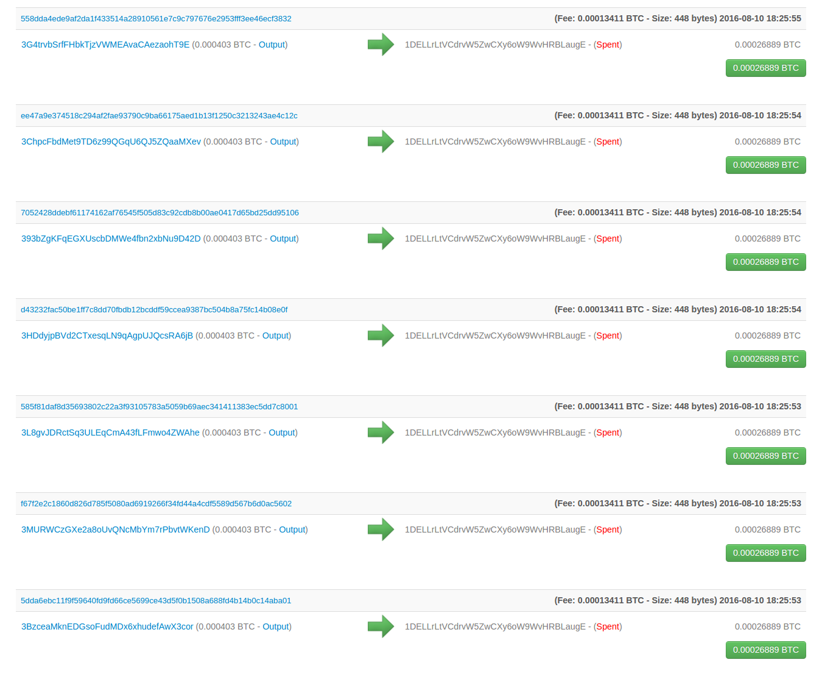
TumbleBit: Implementation
We wrote a proof-of-concept implementation of the Classic Tumbler:
Sourcecode is available on Github.
We “tumbled” 800 users:
You can see the transactions on the mainnet blockchain.
TXIDs avaliable in our paper.
Our implementation is Performant (per TumbleBit payment):
326 KB of Bandwidth,
Puzzle-Solver takes ~0.4 seconds to compute
Total time depends on network latency: No latency ~0.6 seconds. Boston to Tokyo ~6 seconds (clear) and ~11 seconds ...(both parties use TOR)
Notes:
<number>

Slide 47
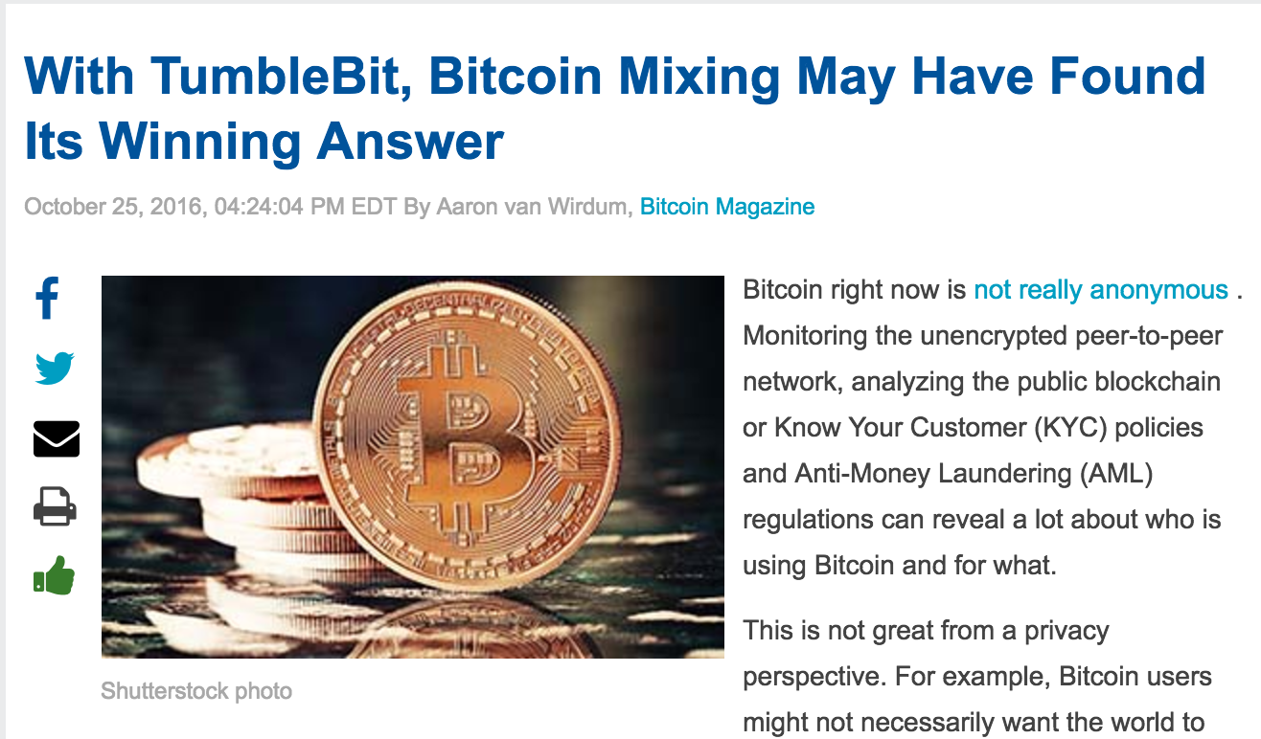
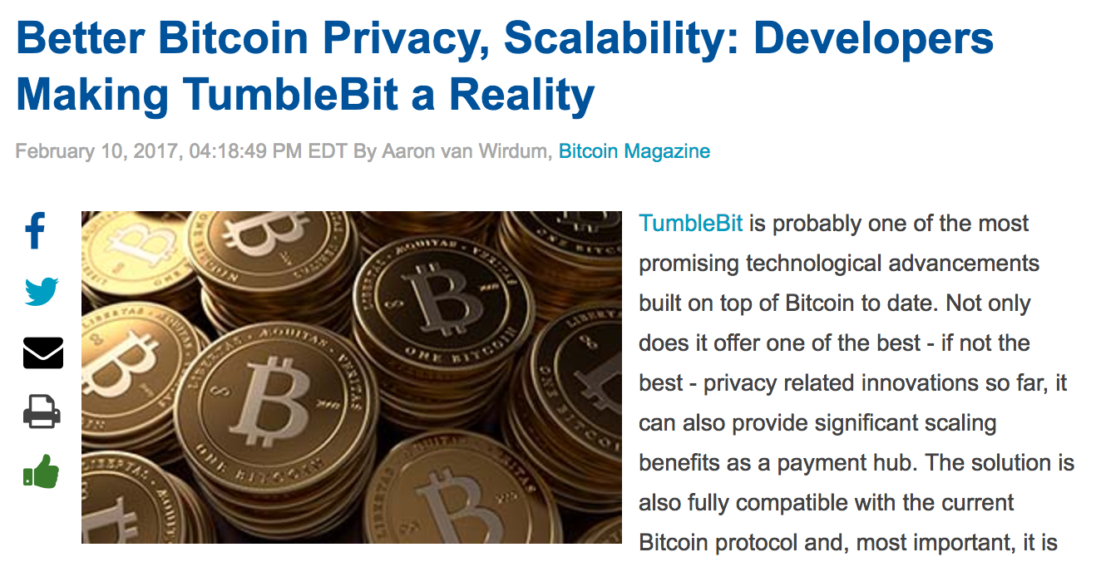
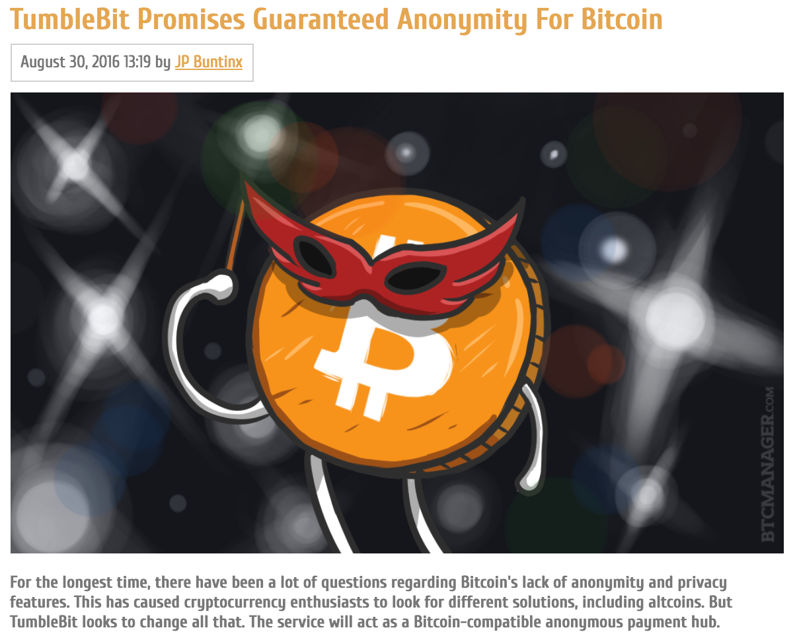
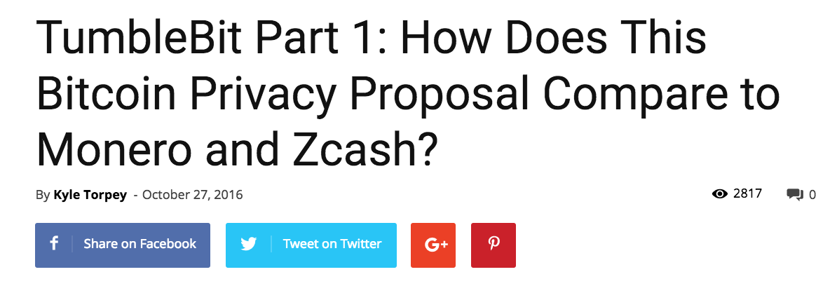
Notes:
<number>

Slide 48
Looking for PhD students and postdocs interested in cryptography and blockchain research.
Talk to me if you are interested!
<number>
Notes:
<number>

Slide 49
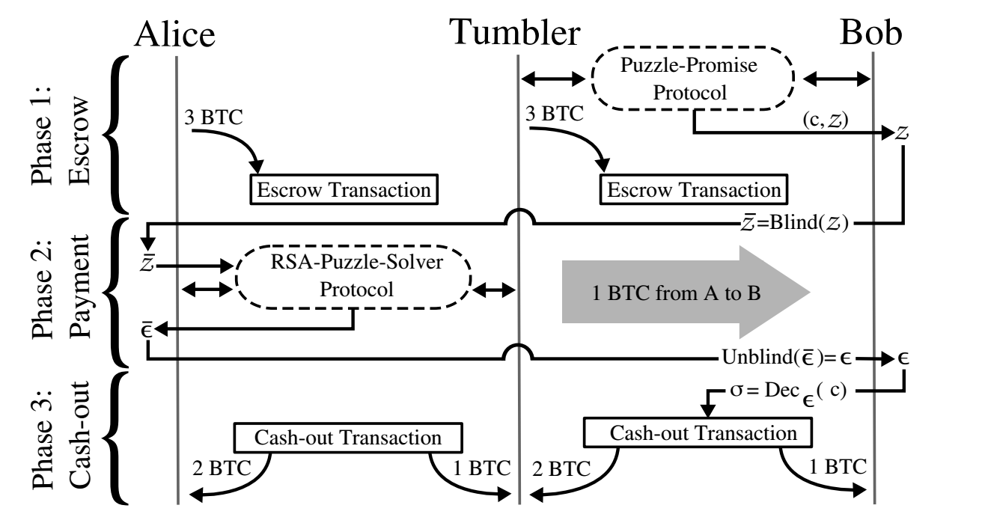
Questions?
Proof-of-concept: https://github.com/BUSEC/TumbleBit
Opensource project: https://github.com/nTumbleBit/nTumbleBit Paper: https://eprint.iacr.org/2016/575.pdf
<number>
Notes:
<number>

